Slide 1
MACHINE LEARNING PROJECT:
Body Fat Prediction Using Machine Learning
Course Code: CSM355 | Submitted To: Himanshu Gajanan Tikle
Submitted By: Nakkala Yogananda Reddy, Reg No: 12216346
University: Lovely Professional University, Punjab

Slide 2

Problem Statement
Issue
Excess adiposity leads to chronic diseases
Current Methods
DEXA costly; calipers operator-dependent
Need
Non-invasive, affordable, accurate body fat estimation
Goal
Develop regression models using anthropometric data

Slide 3
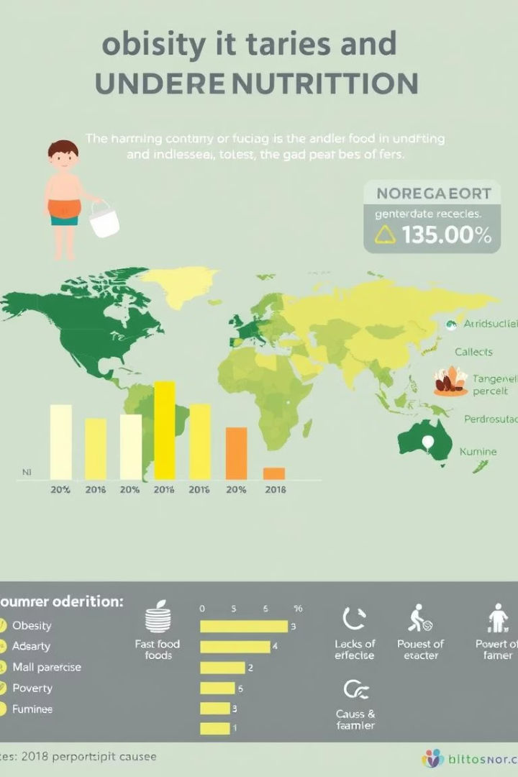
Justification & Significance
Limitations of BMI
Health Hazards
Cannot differentiate fat from muscle mass
Cardiovascular diseases
Type 2 diabetes
Immune deficiencies
Beneficiaries
Healthcare providers
Individuals
Public health organizations
Sports industry

Slide 4
Objectives & Hypotheses
Data & EDA
Modeling & Evaluation
Hypotheses
Acquire and preprocess dataset
Train linear and ensemble regressors
BMI correlates with body fat%
Analyze features and correlations
Abdominal circumference predicts obesity
Evaluate with MAE, MSE, R²
ML models predict body composition accurately

Slide 5
Dataset Overview
Source
Features
UCI Body Fat Percentage Dataset with 245 records
Age, weight, height, BMI, 11 circumference measures
Categories
Measurements
Gender, age group, fitness, health status, diet type
Neck, chest, abdomen, hip, thigh, knee, ankle, limb circumferences

Slide 6
Scope of Study
Inclusions
Exclusions & Limitations
Anthropometric & engineered features
Limited female & pediatric data
Regression targets BodyFat and NavyFat
Not longitudinal
Regression & ensemble modeling techniques
Measurement variability unaccounted
Comprehensive evaluation framework
No deep learning methods

Slide 7



Literature Review & Data Preprocessing
Classical Formulas
Skinfold-based & Navy circumference methods
ML Approaches
SVR, ensemble trees improved accuracy
Interpretability
SHAP and LIME for feature insights

Slide 8
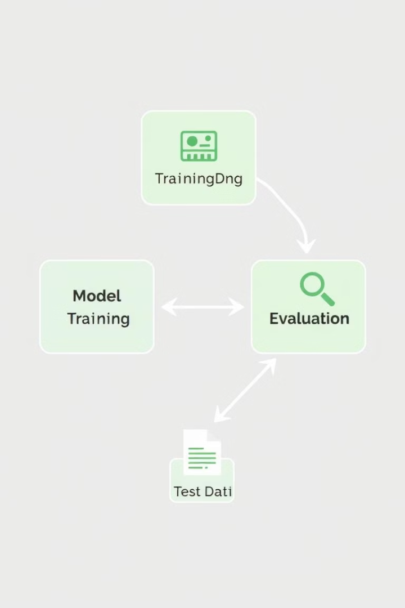
Methodology
Train-Test Split
80/20 stratified split for high-fat groups
Models
Linear, Ridge, Lasso, Random Forest, XGBoost
Validation
5-fold CV with grid search hyperparameter tuning
Metrics
MAE, MSE, RMSE, R² for performance assessment

Slide 9
Results & Discussion
Model
MAE (%)
RMSE (%)
R²
Linear
3.08
4.12
0.72
Ridge
3.05
4.05
0.74
Lasso
3.10
4.15
0.71
Random Forest
2.75
3.60
0.80
XGBoost
2.70
3.55
0.82
XGBoost outperformed others, reducing error by ~12%. Abdomen circumference key predictor.

Slide 10
Conclusion & Future Work
Conclusion
ML models accurately predict body fat using simple measures
Future Directions
Incorporate diverse demographics
Use longitudinal data for dynamic analysis
Deploy interactive web and mobile platforms
Integrate wearable lifestyle data
Explore contactless measurement tech

